Slide 1


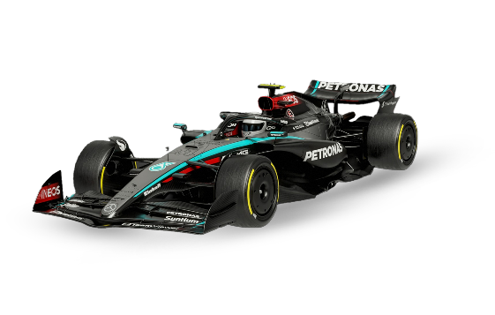
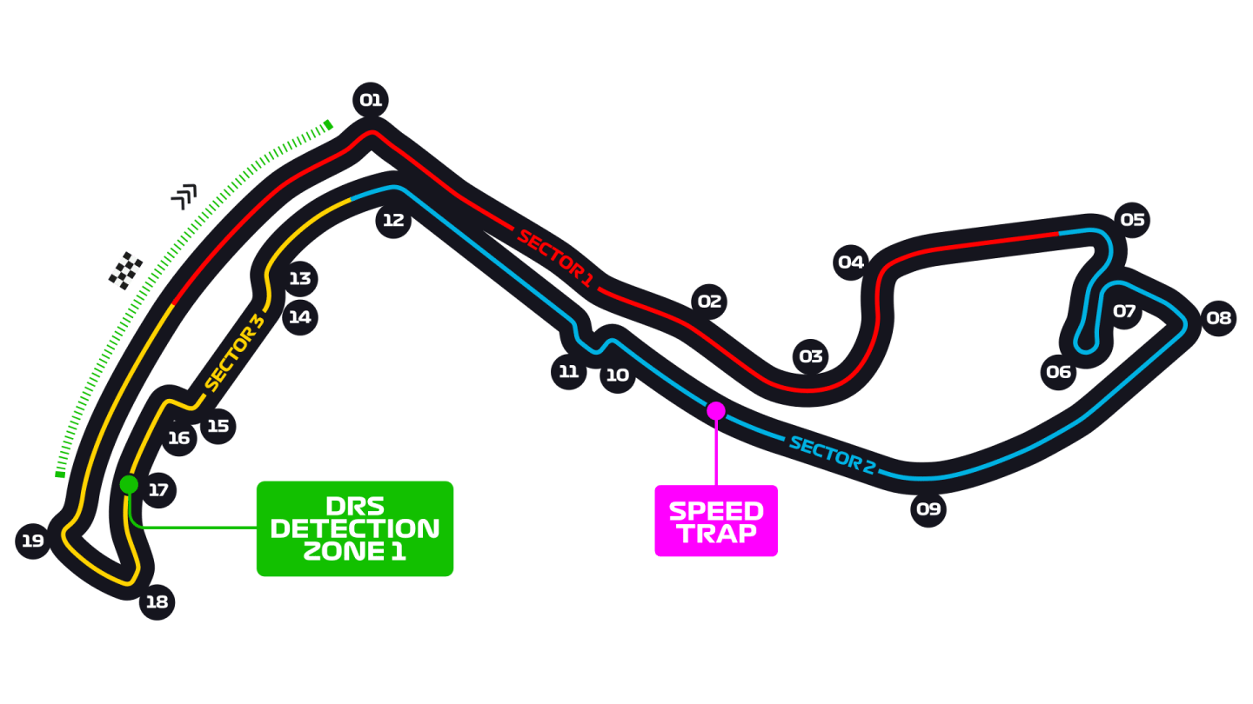
Hackaton GP Monaco 2025
F1 Social Analytics Engine
Antonio Boccarossa
Francesco Brunello
Vincenzo Luigi Bruno
Salvatore Cangiano

Slide 2

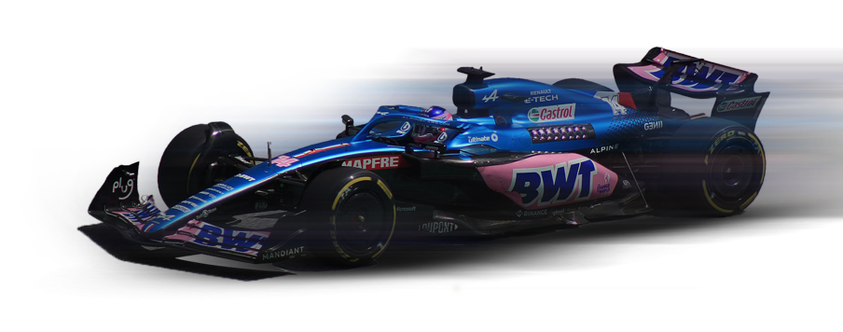
The Problem
The Solution
Global events like the Monaco GP generate an enormous volume of conversations across social media
It's nearly impossible for companies or teams to manually analyze millions of posts, comments, and opinions.
Crucial insights about fan sentiment, team performance, or sponsor perception can be lost.
An automated system that extracts, analyzes, and summarizes fan sentiment from the social media sphere.
Transforms data "noise" into actionable insights for teams, sponsors, and organizers.

Slide 3
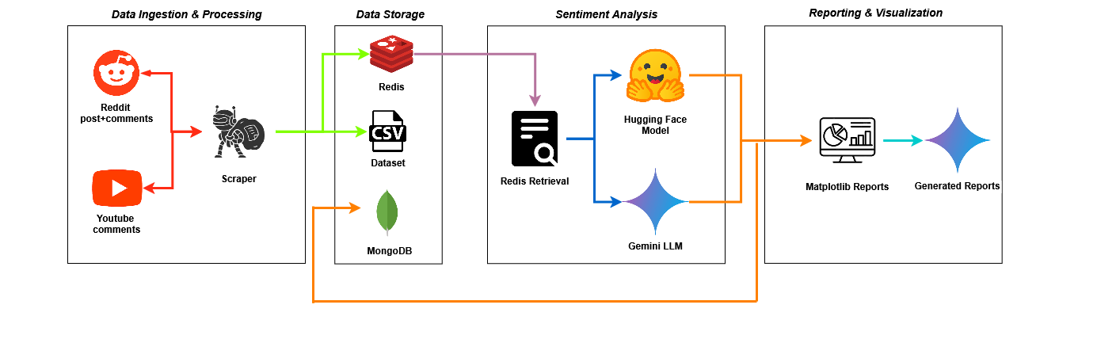
Our Architecture

Slide 4

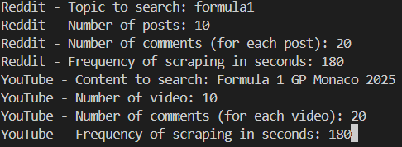

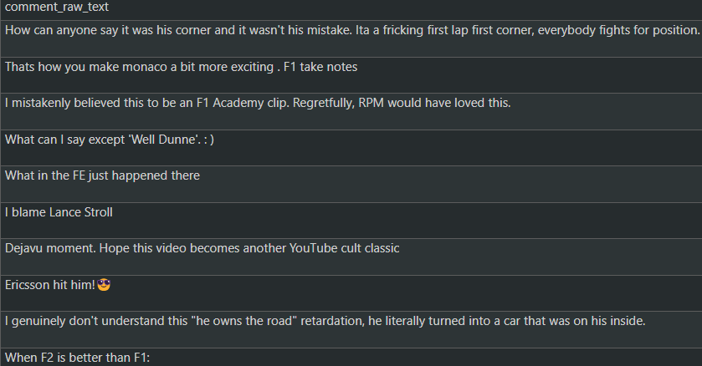
Scraping
We use praw to access posts and comments from specific subreddits (e.g., r/formula1).
We leverage googleapiclient to search for videos (e.g., 'GP Monaco 2025') and collect comments.

Slide 5



Smart data Buffer
Unique System
Redis acts as a high-speed intermediary between the scraping module and the sentiment analysis module.
Decoupling
Speed & Efficiency
Scalability
Duplicate Prevention
Scraping Module
AI Module
Redis Buffer

Slide 6
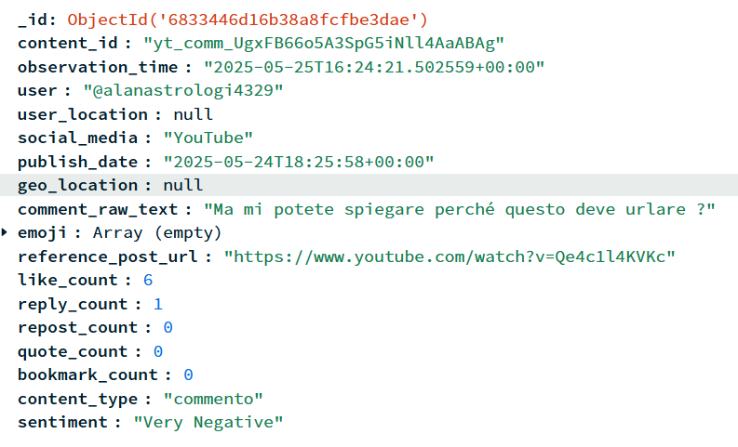



Sentiment Analysis
We leverage two distinct AI models, carefully chosen for their strengths in processing specific types of social media content
YouTube Comments → Hugging Face Model
Reddit Posts & Comments → Google Gemini API

Slide 7
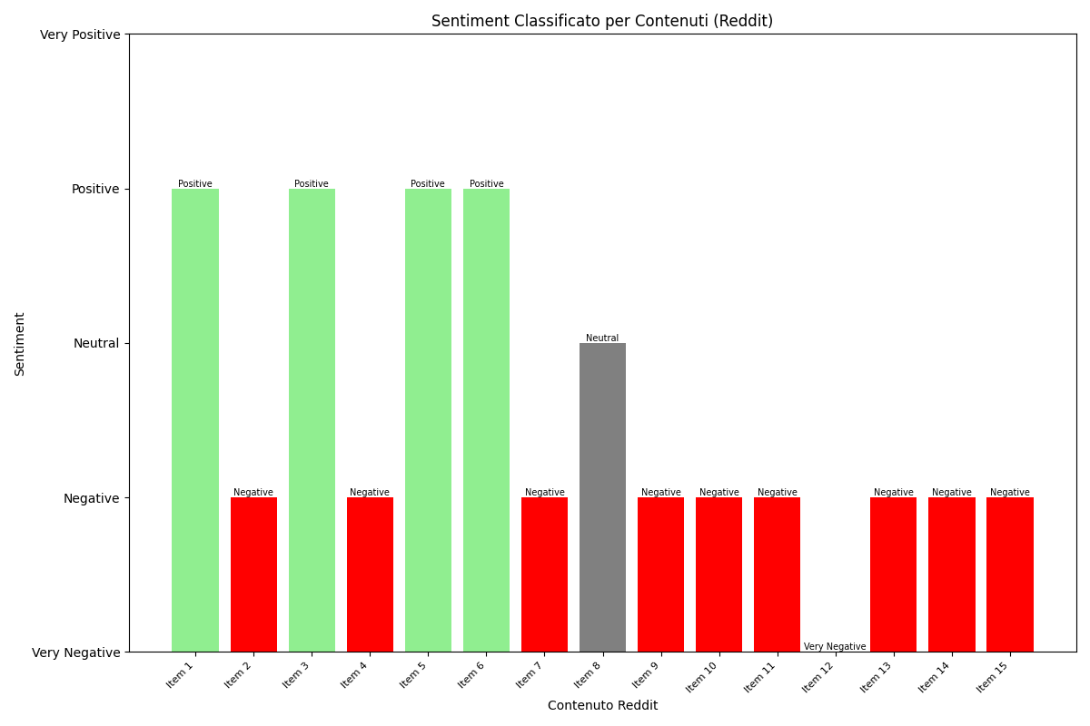
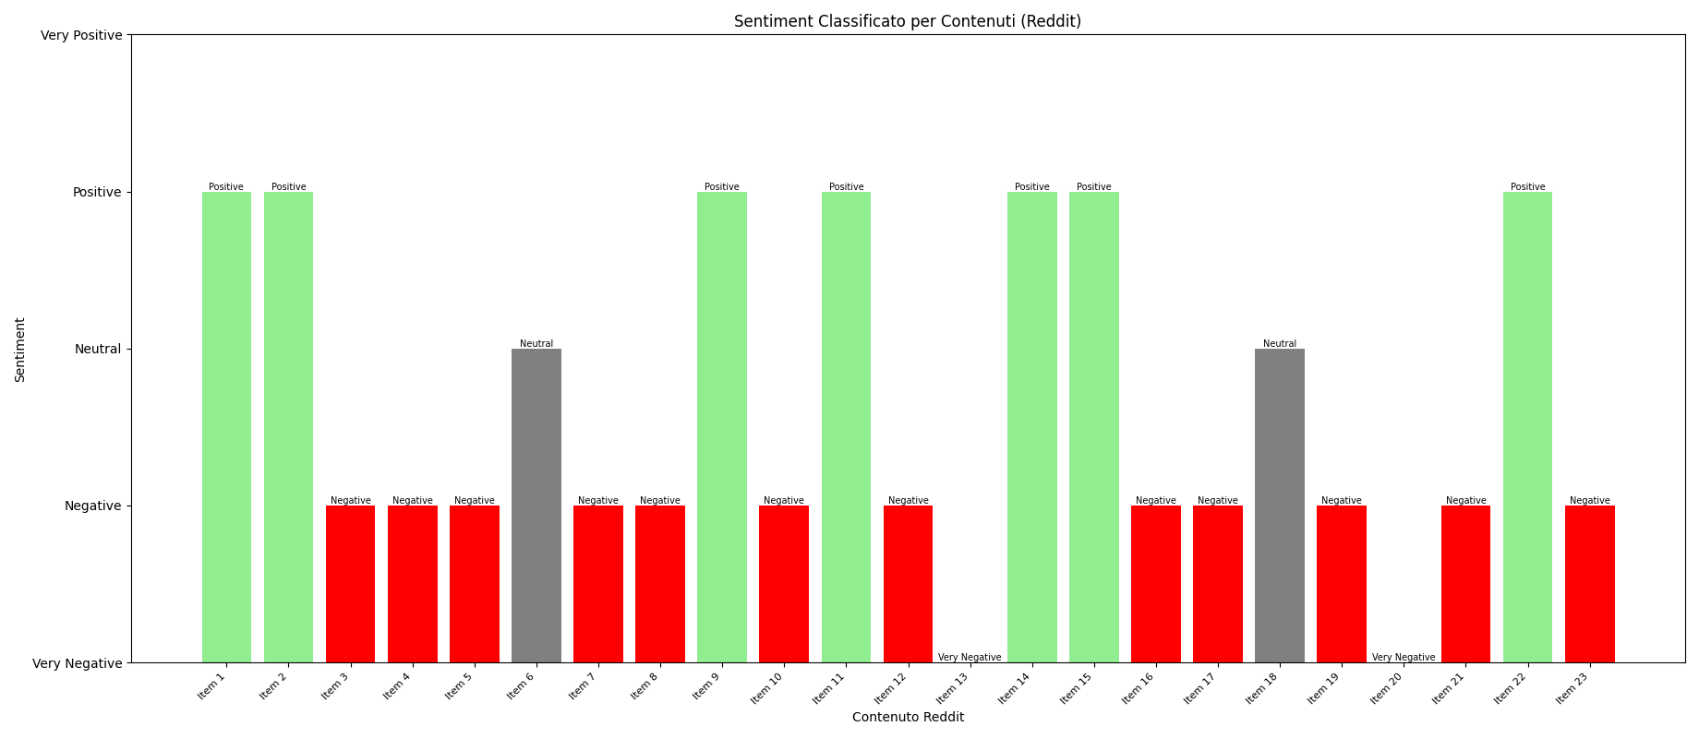
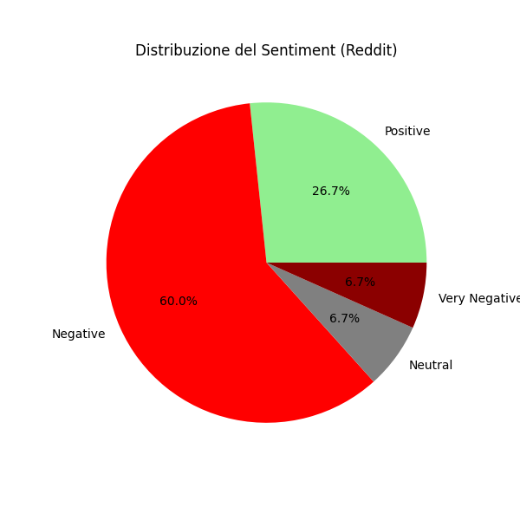
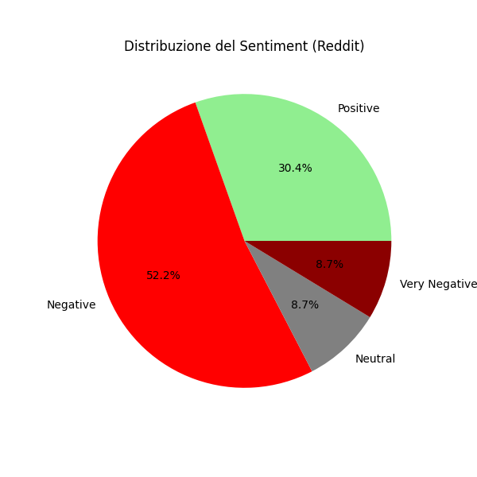
Results
For Reddit
During the Race
After the Race

Slide 8
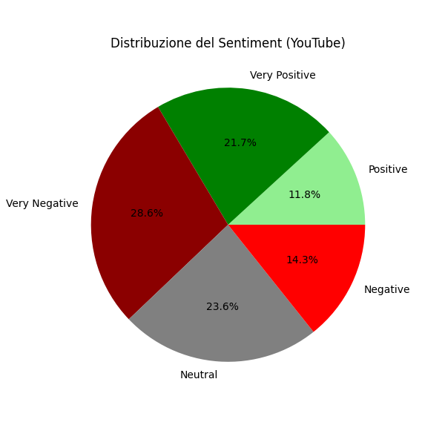
Some Results
For YouTube
During the Race

Slide 9
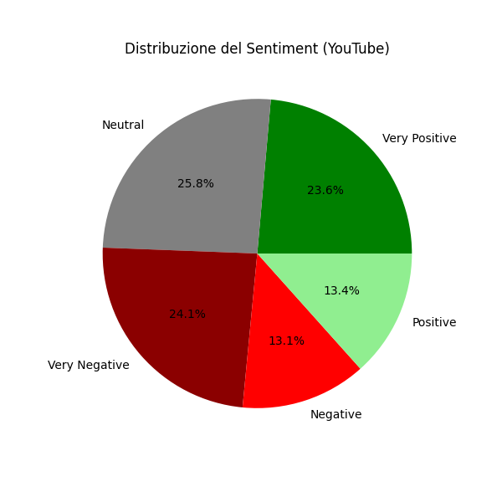
Some Results
For YouTube
After the Race

Slide 10

Thank you

